Slide 1
TEAM 22
Design
II
Review
FACE TRACKING

Slide 2
Introduction Problem
A new in-car interaction method?

Slide 3
Introduction Needs & Solution
A gesture tracking system?
Gesture control!
A object tracking system
A gesture
tracking system
A face tracking system!

Slide 4
Function Decomposition
Detect driver’s face → Detector
Track face movement → Tracker

Slide 5
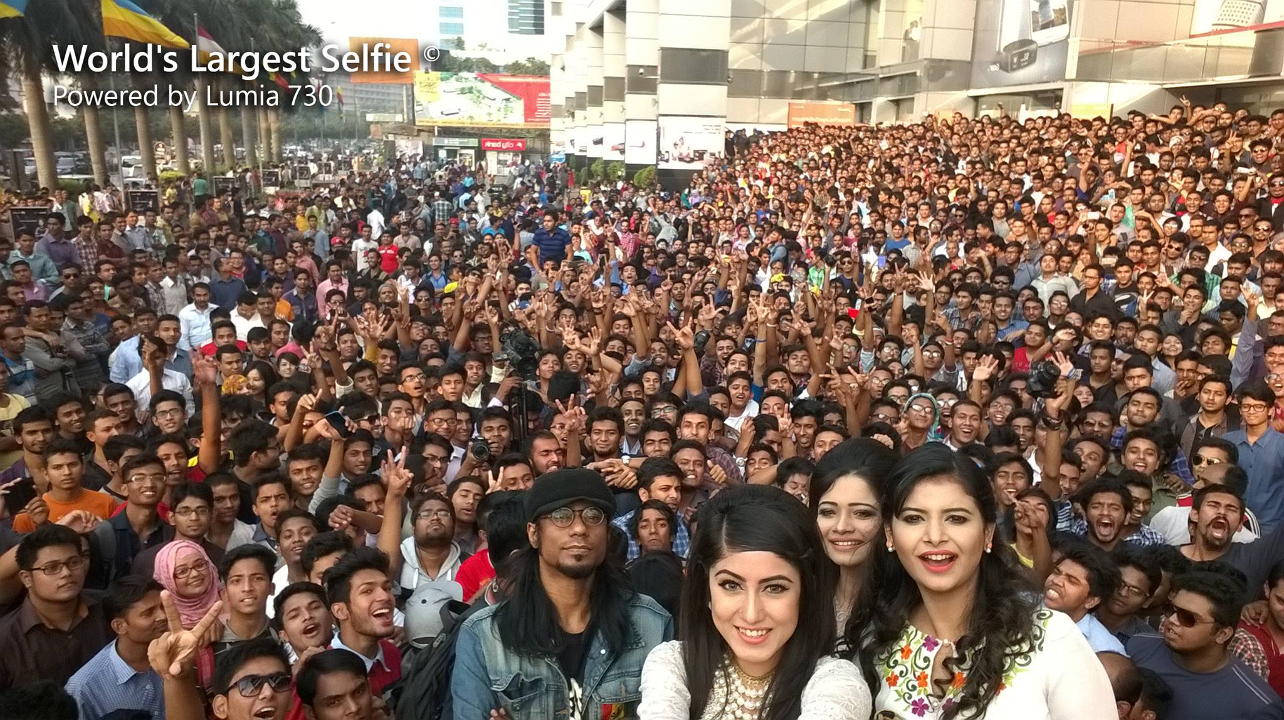
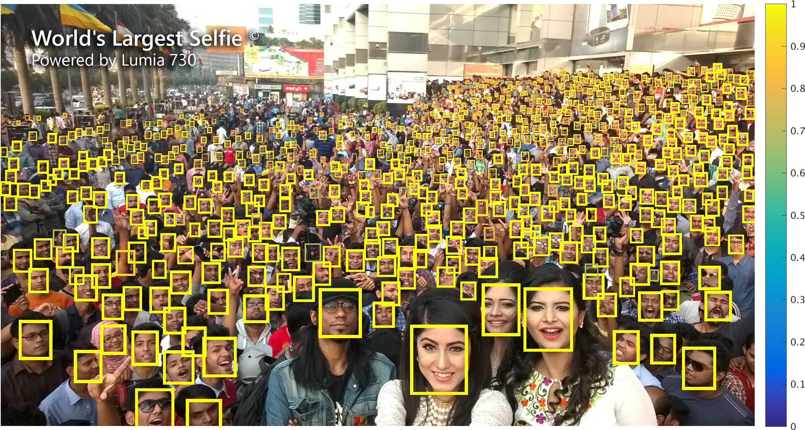
Function Decomposition Detector
A function that detect the presence of a particular object in a given picture.
Detector
Source:https://github.com/peiyunh/tiny

Slide 6
Function Decomposition Tracker
A function that locate a particular object based on its former position.

Slide 7
Proposed Ideas
Tracking:
Kernelized Correlation Filters
Pure Recognition
Struck Tracker
KCF with detection
Detection:
CNN face detector

Slide 8
Proposed Ideas KCF

Slide 9
Proposed Ideas Pure Detection

Slide 10
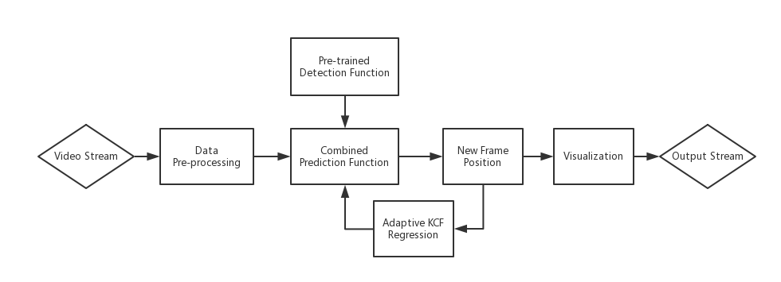
Proposed Ideas KCF with Detection
Take advantage of the KCF tracker to adaptively model the moving object in real time
Use pre-trained recognition function to enhance the accuracy on specific kind of object (face, gesture)
Use recognition function to real-time determine the start and the end of a track

Slide 11
Idea Selection Feasibility and Risk
 | Feasibility | Risk
KCF | Feasible, but not actually complete in real-world application. | May cause failure if the user head moves outside the camera during tracking May cause failure if the target is lost and the tracking system follows the wrong object
Pure Detection | Feasible, but naïve. | May cause tracking error if there is another face appear in the camera The detection may cause the large localization error that influence the tracking trajectory recording
KCF with Detection | Feasible | It may be hard to train a high-performance detector There may exist difficulties in implementation The speed may be influenced our expectation is wrong

Slide 12
Idea Selection Decision-matrix Method
 | Weight | KCF | Pure Detection | KCF with Detection
Speed | 3 | S | + | S
Precision | 5 | S | + | +
Recall | 5 | + | S | +
Portability | 4 | + | - | S
Robustness | 4 | S | - | +
Stability | 2 | S | S | +
+ |  | 9 | 8 | 16
- |  | 0 | 8 | 0
score |  | 9 | 0 | 16

Slide 13
Idea Selection Comparison
KCF with Detection over Pure Detection:
KCF will provide a adaptive model for the moving object, which will provide a more stable and precise tracking sequence.
Pure Detection is not robust for multi-target tracking
KCF with Detection over pure KCF:
Detection function will give the help the tracker determine whether there is a person inside or not, can help avoid the weakness of KCF tracker in real-world tracking task
Pre-trained model will help improve the accuracy

Slide 14
Selected Model Pipeline

Slide 15
Selected Model Difficulties
The face detection model can be time-consuming to train
No enough in-car video for testing and training
Modification of KCF source code can be tricky
The live stream input may have engineering issue
We should consider tracking speed during implementation

Slide 16
Progress Update
Finalized the design
Implemented the demo of the KCF on video benchmark
A rough data preprocessing function

Slide 17
Progress Update Demo

Slide 18
Progress Update Next step
Modify the code for live stream input
Analyze the result quantitatively
Train a high accuracy face recognition model
Modify the score function by combining the Recognition function and KCF tracker

Slide 19
Q&A

